Slide 1

Communications and
Documentation
CHAPTER 4

Slide 2
National EMS Education Standard Competencies (1 of 5)
Preparatory
Applies fundamental knowledge of the emergency medical services (EMS) system, safety/well-being of the emergency medical technician (EMT), medical/legal and ethical issues to the provision of emergency care.
Notes:
National EMS Education Standard Competencies
Preparatory
Applies fundamental knowledge of the emergency medical services (EMS) system, safety/well-being of the emergency medical technician (EMT), medical/legal, and ethical issues to the provision of emergency care.

Slide 3
National EMS Education Standard Competencies (2 of 5)
Therapeutic Communication
Principles of communicating with patients in a manner that achieves a positive relationship
  Interviewing techniques
  Adjusting communication strategies for age, stage of development, patients with special needs, and differing cultures
  Verbal defusing strategies
  Family presence issues
Notes:
National EMS Education Standard Competencies
Therapeutic Communication
Principles of communicating with patients in a manner that achieves a positive relationship
• Interviewing techniques
• Adjusting communication strategies for age, stage of development, patients with special needs, and differing cultures
• Verbal defusing strategies
• Family presence issues

Slide 4
National EMS Education Standard Competencies (3 of 5)
EMS System Communication
Communication needed to
  Call for resources
  Transfer care of the patient
  Interact within the team structure
  EMS communication system
  Communication with other health care professionals
  Team communication and dynamics
Notes:
National EMS Education Standard Competencies
EMS System Communication
Communication needed to
• Call for resources
• Transfer care of the patient
• Interact within the team structure
• EMS communication system
• Communication with other health care professionals
• Team communication and dynamics

Slide 5
National EMS Education Standard Competencies (4 of 5)
Documentation
  Recording patient findings
  Principles of medical documentation and report writing
Notes:
National EMS Education Standard Competencies
Documentation
• Recording patient findings
• Principles of medical documentation and report writing

Slide 6
National EMS Education Standard Competencies (5 of 5)
Medical Terminology
Uses foundational anatomical and medical terms and abbreviations in written and oral communication with colleagues and other health care professionals
Notes:
National EMS Education Standard Competencies
Medical Terminology
Uses foundational anatomical and medical terms and abbreviations in written and oral communication with colleagues and other health care professionals.

Slide 7
Introduction (1 of 3)
Communication is the transmission of information to another person.
  Verbal
  Nonverbal (through body language)
Verbal communication skills are important.
  Enables you to gather critical information, coordinate with other responders, and interact with other health care professionals
Notes:
Lecture Outline
Introduction
A. Communication is the transmission of information to another person, whether it is verbal or through body language (nonverbal).
1. Effective communication is an essential component of prehospital care.
2. It is necessary to achieve a positive relationship with patients and coworkers.
B. Verbal communication skills are important.
1. Enables you to gather information from the patient and bystanders
2. Makes it possible for you to coordinate all the responders who are often present at the scene
3. An integral part of transferring the patient’s care to the nurses and physicians at the hospital

Slide 8
Introduction (2 of 3)
Documentation
  Patient’s permanent medical record
  Demonstrates appropriate care was delivered
  Helps others in patient’s future care
Complete patient records
  Guarantee proper transfer of responsibility
  Comply with requirements of health departments and law enforcement agencies
  Fulfill your organization’s administrative needs
Notes:
Lecture Outline
C. Documentation
1. The written or electronically recorded part of the patient’s permanent medical record
2. Demonstrates that appropriate care was delivered
3. Communicates the patient’s story to others who may participate in the patient’s future care
4. Adequate reporting and accurate records ensure the continuity of patient care.
5. Complete patient records
a. Guarantee proper transfer of responsibility
b. Comply with requirements of health departments and law enforcement agencies
c. Fulfill your organization’s administrative needs
6. Drives funding for EMS research

Slide 9
Introduction (3 of 3)
Computer, radio and telephone communications
  Link the EMT to EMS, fire department, and law enforcement
  You must know:
    What your system can and cannot do
    How to use the system efficiently and effectively
Notes:
Lecture Outline
D. Computer, radio and telephone communications
1. Link the EMT to other members of the EMS, fire department, and law enforcement communities
2. You must know:
a. What your system can and cannot do
b. How to use the system efficiently and effectively

Slide 10
Therapeutic Communication (1 of 4)
Uses various communication techniques and strategies:
  Both verbal and nonverbal
  Encourages patients to express how they feel
  Achieves a positive relationship with each patient
Notes:
Lecture Outline
II. Therapeutic Communication
A. Therapeutic communication uses various communication techniques and strategies.
1. Both verbal and nonverbal
2. Encourages patients to express how they feel and achieves a positive relationship with each patient

Slide 11
Therapeutic Communication (2 of 4)
Shannon-Weaver communication model
  Sender takes a thought
  Encodes it into a message
  Sends the message to the receiver
  Receiver decodes the message
  Sends feedback to the sender
Notes:
Lecture Outline
B. The Shannon-Weaver communication model was developed to assist in the mathematical theory of communication for Bell Telephone Labs in the late 1940s. This model remains a valuable tool in understanding human communications:
1. Sender takes a thought
2. Encodes it into a message
3. Sends the message to the receiver
4. Receiver decodes the message
5. Sends feedback to the sender

Slide 12
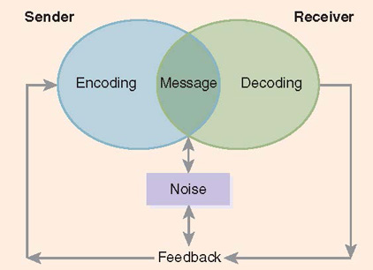
Therapeutic Communication (3 of 4)
FIGURE 4-1 Shannon–Weaver communication model.
© Jones & Bartlett Learning.
Notes:
The figure on this screen illustrates how the Shannon-Weaver communication model works.

Slide 13
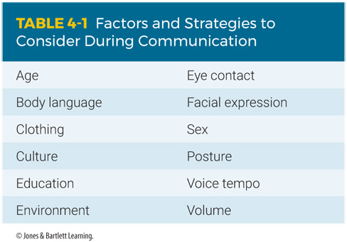
Therapeutic Communication (4 of 4)
Notes:
The table on this screen lists the factors and strategies to consider during communication.

Slide 14
Age, Culture, and Personal Experience (1 of 2)
Influences how a person communicates
Body language and eye contact are greatly affected by culture.
  In some cultures, expressing emotion is a weakness.
  In other cultures, it is impolite to look away while speaking.
Notes:
Lecture Outline
C. Age, culture, and personal experience
1. Influences how a person communicates
2. Body language and eye contact are greatly affected by culture.
a. In some cultures, people are encouraged to express emotion, while others view it as a sign of weakness.
b. In other cultures, it is impolite to look away while speaking.

Slide 15
Age, Culture, and Personal Experience (2 of 2)
Tone, pace, and volume of language
  Reflect mood of the person and perceived importance of the message
Ethnocentrism: considering your own cultural values more important than those of others
Cultural imposition: forcing your values onto others
Notes:
Lecture Outline
3. Tone, pace, and volume of the language
a. Offer clues about the mood of the person communicating
b. Provide insight into the perceived importance of the message
4. Ethnocentrism: considering your own cultural values more important than those of others
a. People tend to translate messages they receive using their own worldview.
5. Cultural imposition: forcing your values onto others
a. Health care providers may consciously or subconsciously force their cultural values onto their patients because they believe their values are better.

Slide 16
Nonverbal Communication (1 of 3)
Body language provides more information than words alone.
  Even without exchanging any words, you should be able to tell the mood of your patient.
Facial expressions, body language, and eye contact are powerful communication tools.
  Help people understand messages being sent
Notes:
Lecture Outline
D. Nonverbal communication
1. Body language provides more information than words alone.
a. Even without exchanging any words, you should be able to tell the mood of your patient.
E. Facial expressions, body language, and eye contact
1. Eye contact and body language are powerful communication tools.
2. Pay attention to body language—both your own and that of your patients.
3. Physical cues will help you and your patient to truly understand the message being sent.

Slide 17
Nonverbal Communication (2 of 3)
When treating a potentially hostile patient, be aware of your own body language.
Stay calm and try to defuse the situation:
  Assess the safety of the scene.
  Do not assume an aggressive posture.
  Make good eye contact, but do not stare.
  Speak calmly, confidently, and slowly
  Never threaten the patient, either verbally or physically.
Notes:
Lecture Outline
4. When you are treating a potentially hostile patient, it is important that you understand and be aware of your own body language. Stay calm and try to defuse the situation:
a. Assess the safety of the scene.
b. Do not assume an aggressive posture.
c. Make good eye contact, but do not stare.
d. Speak calmly, confidently, and slowly.
e. Never threaten the patient, either verbally or physically.

Slide 18
Nonverbal Communication (3 of 3)
Physical factors
  Literal noise, or sounds in the environment, lighting, distance, or physical obstacles may affect your communication.
  Cultural norms often dictate the amount of space, or proximity, between people when communicating.
  Gestures, body movements, and attitude toward the patient are critically important.
Notes:
Lecture Outline
F. Physical factors
1. Noise: anything that dampens or obscures true meaning of message
a. Literal noise, or sounds in the environment, lighting, distance, or physical obstacles may affect your communication.
2. Cultural norms often dictate the amount of space, or proximity, between people when communicating.
a. As a person gets closer, a greater sense of trust must be established.
3. Your gestures, body movements, and attitude toward the patient are critically important in gaining the trust of both patient and family.

Slide 19
Verbal Communication (1 of 2)
Asking questions is a fundamental aspect of prehospital care.
  Open-ended questions require some level of detail.
    Use whenever possible.
    Example: “What seems to be bothering you?”
Notes:
Lecture Outline
G. Verbal communication
1. One of the most fundamental functions of EMTs is to ask patients questions.
2. Open-ended questions require some level of detail in the response.
a. Use whenever possible
b. Example: “What seems to be bothering you?”

Slide 20
Verbal Communication (2 of 2)
  Closed-ended questions can be answered in very short responses.
  Response is sometimes a single word.
  Use if patients cannot provide long answers.
  Example: “Are you having trouble breathing?”
Notes:
Lecture Outline
3. Closed-ended questions can be answered in very short responses.
a. Response is sometimes a single word like yes or no
b. Use if patients cannot provide long answers. Example: “Are you having trouble breathing?”
c. May miss important issues if pertinent questions are not asked

Slide 21
Communication Tools
Facilitation
Pause
Reflection
Empathy
Clarification
Confrontation
Interpretation
Explanation
Summary
Notes:
Lecture Outline
4. You can use many powerful communication tools when trying to obtain information from patients:
a. Facilitation: encouraging the patient to talk more or provide more information
b. Pause: gives the patient space and time to think and respond
c. Reflection: restating a patient’s statement made to you to confirm your understanding
d. Empathy: being sensitive to the patient’s feelings and thoughts
e. Clarification: asking the patient to explain what he or she meant by an answer
f. Confrontation: making the patient who is in denial or in a mental state of shock focus on urgent and life-critical issues
g. Interpretation: restating the patient’s complaint to confirm your understanding
h. Explanation: providing factual information to support a conversation
i. Summary: providing the patient with an overview of the conversation and the steps you will be taking

Slide 22
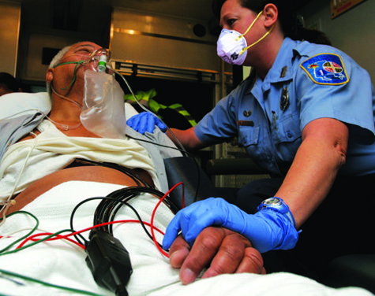
Interviewing Techniques
When interviewing a patient, consider using touch to show caring and compassion.
  Use consciously and sparingly.
  Avoid touching the torso, chest, and face.
FIGURE 4-3 Using touch conveys a sense of caring and compassion.
© Jones & Bartlett Learning.
Notes:
Lecture Outline
5. When interviewing a patient, consider the careful use of touch to show caring and compassion.
a. Touch is a powerful tool.
b. Use it consciously and sparingly.
c. If you are going to touch the patient, approach slowly and touch the patient’s shoulder or arm respectfully or consider holding the patient’s hand.
d. Avoid touching the patient’s torso, chest, or face simply as a means of communication, because these areas are often viewed as intimate.

Slide 23
Interviewing Techniques to Avoid
Providing false assurance or reassurance
Giving unsolicited advice
Asking leading or biased questions
Talking too much
Interrupting
Using “why” questions
Using authoritative language
Speaking in professional jargon
Notes:
Lecture Outline
6. Interview techniques to avoid
a. Providing false assurance or reassurance
b. Giving unsolicited advice
c. Asking leading or biased questions
d. Talking too much
e. Interrupting
f. Using “why” questions
g. Using authoritative language
h. Speaking in professional jargon

Slide 24
Presence of Family, Friends, and Bystanders
Friends and family may be valuable during the patient interview process.
Allow the patient to answer even if well-meaning family members attempt to answer for the individual.
Do not be afraid to ask others to step aside for a moment.
Notes:
Lecture Outline
7. Presence of family, friends, and bystanders
a. They may be valuable during the patient interview process.
b. Be sure to allow the patient to answer if he or she is able to and wants to, even if well-meaning family members attempt to answer for the individual.
c. Do not be afraid to ask others to step aside for a moment while you talk to the patient.
d. You may need to decide if having family and friends nearby will help or hinder care.

Slide 25
Golden Rules (1 of 2)
Make and keep eye contact at all times.
Provide your name and use the patient’s proper name.
Tell the patient the truth.
Use language the patient can understand.
Be careful what you say about the patient to others.
Be aware of your body language.
Notes:
Lecture Outline
8. Golden Rules to help calm and reassure a patient
a. Make and keep eye contact at all times.
b. Provide your name and use the patient’s proper name.
c. Tell the patient the truth.
d. Use language the patient can understand.
e. Be careful what you say about the patient to others.
f. Be aware of your body language.

Slide 26
Golden Rules (2 of 2)
Speak slowly, clearly, and distinctly.
If the patient is hard of hearing, face the patient so he or she can read your lips.
Allow the patient time to answer or respond.
Act and speak in a calm, confident manner.
Notes:
Lecture Outline
g. Speak slowly, clearly, distinctly.
h. If the patient is hard of hearing, face the patient so he or she can read your lips.
i. Allow the patient time to answer or respond.
j. Act and speak in a calm, confident manner.

Slide 27
Emotional Intelligence (1 of 4)
Ability to understand and manage your emotions and properly respond to others’ emotions
Helps with:
  Defusing conflict
  Building rapport
  Communicating effectively
  Managing difficult situations
Notes:
Lecture Outline
H. Emotional intelligence (people skills)
1. The ability to understand and manage your own emotions and properly respond to others’ emotions.
2. Helps defuse conflict, build a rapport, communicate more effectively, and manage difficult situations.

Slide 28
Emotional Intelligence (2 of 4)
Attributes of emotional intelligence
  Self-awareness
  Self-regulation
  Motivation
  Empathy
  Social skills
Notes:
Lecture noted
3. Attributes of emotional intelligence
a. Self-awareness: the ability to recognize your emotions and how they affect your thoughts and behavior.
b. Self-regulation: the ability to control impulsive emotions and behaviors and to manage emotions in a positive way.
c. Motivation: the ability to motivate yourself and others in a positive direction.
d. Empathy: the ability to understand the concerns, emotions, and needs of others by picking up on communication and social cues and clues.
e. Social skills: the ability to develop and maintain positive rapport and relationships through effective communications.

Slide 29
Emotional Intelligence (3 of 4)
Improving emotional intelligence
  Assess how you react to a stressful situation.
  Practice mindfulness.
    Focus attention on the present moment.
  Take responsibility for your actions.
  Consider how your actions will affect others.
Notes:
Lecture Outline
4. Understanding and improving your own emotional intelligence
a. Assess how you react to a stressful situation. Manage your frustration, and work on staying calm and in control when faced with minor irritations.
b. Practice mindfulness: focus your attention on the present moment, without blame and judgment of yourself and others.
c. Take responsibility for your actions.
d. Consider how your actions will affect others.

Slide 30
Emotional Intelligence (4 of 4)
Behavioral change stairway model
Developed by the FBI to manage hostage situations
Adapted for crisis management
  Employ active listening.
  Display empathy.
  Build a rapport.
  Exert influence.
  Initiate behavior change.
Notes:
Lecture Outline
5. Behavioral change stairway model
a. Developed by the Federal Bureau of Investigation to manage hostage situations and adapted for most crisis situations:
i. Employ active listening.
ii. Display empathy.
iii. Build a rapport.
iv. Exert influence.
v. Initiate behavior change.

Slide 31
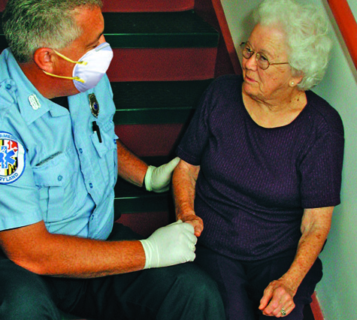
Communicating With Older Patients (1 of 5)
Identify yourself.
Present yourself as competent, confident, and caring.
Do not assume that an older patient is senile or confused.
FIGURE 4-5 You need a great deal of compassion and patience when caring for older patients. Never assume that a patient is senile or confused.
© Jones & Bartlett Learning. Courtesy of MIEMSS.
Notes:
Lecture Outline
I. Communicating with older patients
1. Identify yourself.
2. Present yourself as competent, confident, and caring.
3. Do not assume that an older patient is senile or confused.

Slide 32
Communicating With Older Patients (2 of 5)
You may encounter hostility, irritability, and some confusion.
  Do not assume this is normal behavior.
Approach an older patient slowly and calmly.
Allow plenty of time for the patient to respond to your questions.
Notes:
Lecture Outline
4. You may encounter hostility, irritability, and some confusion.
a. Do not assume this is normal behavior.
b. Assess for signs of hypoxia, CVA, drug overdose, infection, hypoglycemia, hyperglycemia, or insufficient perfusion.
5. Approach an older patient slowly and calmly.
6. Allow plenty of time for the patient to respond to your questions.

Slide 33
Communicating With Older Patients (3 of 5)
Watch for signs of confusion, anxiety, or impaired hearing or vision.
The patient should feel confident that you are in charge and that everything possible is being done for him or her.
Be patient!
Notes:
Lecture Outline
7. Watch for signs of confusion, anxiety, or impaired hearing or vision.
8. The patient should feel confident that you are in charge and that everything possible is being done for him or her.
9. Be patient!

Slide 34
Communicating With Older Patients (4 of 5)
Older patients:
  Often do not feel much pain
  May not be fully aware of important changes in their body systems
  You must be especially vigilant for objective changes.
Notes:
Lecture Outline
10. Older patients:
a. Often do not feel much pain
b. May not be fully aware of important changes in their body systems
c. You must be especially vigilant for objective changes.

Slide 35
Communicating With Older Patients (5 of 5)
When possible, give patients time to pack a few personal items before leaving for hospital.
Locate hearing aids, glasses, and dentures before departure.
Older patients are often worried about the safety of their home, valuable items, and pets.
Notes:
Lecture Outline
11. When possible, give the patient time to pack a few personal items before leaving for the hospital.
12. Locate any hearing aids, eyeglasses, and dentures before departure.
13. Older patients are often worried about the safety of their home, valuable items, and pets.
a. Share these concerns with the person assuming care of the patient at the hospital.

Slide 36
Communicating With Children (1 of 4)
Fear is most obvious and severe in children.
Children may be frightened by:
  Your uniform
  The ambulance
  A crowd of people gathered around them
Notes:
Lecture Outline
J. Communicating with children
2. Fear is most obvious and severe in children.
3. Children may be frightened by:
a. Your uniform
b. The ambulance
c. A crowd of people gathered around them

Slide 37
Communicating With Children (2 of 4)
Let a child keep a favorite toy, doll, security blanket.
If possible, have a family member or friend nearby.
  If practical, let the parent or guardian hold the child during evaluation and treatment.
Notes:
Lecture Outline
4. Let a child keep a favorite toy, doll, or security blanket.
5. If possible, have a family member or friend nearby.
a. If practical, let the parent or guardian hold the child during evaluation and treatment.

Slide 38
Communicating With Children (3 of 4)
Be honest.
  Children easily see through lies or deception.
Tell the child ahead of time if something will hurt.
Respect the child’s modesty.
Notes:
Lecture Outline
6. Be honest. Children easily see through lies or deception.
7. Tell the child ahead of time if something will hurt.
8. Respect the child’s modesty.

Slide 39
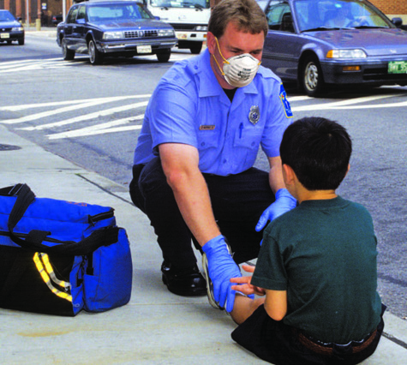
Communicating With Children (4 of 4)
Speak in a professional, friendly way.
Maintain eye contact.
Position yourself
at the child’s
level.
FIGURE 4-6 Maintain eye contact with a child to let the child know that you are there to help and that you can be trusted.
© Jones & Bartlett Learning. Courtesy of MIEMSS.
Notes:
Lecture Outline
9. Speak in a professional, yet friendly way.
10. Use an appropriate tone and vocabulary.
11. Maintain eye contact.
12. Position yourself down at the child’s level.
a. Do not tower over a child.

Slide 40
Communicating With Hearing-Impaired Patients (1 of 3)
Most have normal intelligence and are not embarrassed by their disability.
Position yourself so the patient can see your lips.
Hearing aids
  Be careful that they are not lost during an accident.
  They may be forgotten if the patient is confused.
  Ask family about use of a hearing aid.
Notes:
Lecture Outline
K. Communicating with patients who are hard of hearing
1. Most people who are hard of hearing have normal intelligence and are not embarrassed by their disability.
2. Position yourself so that the patient can see your lips.
3. Hearing aids
a. Be careful that they are not lost during an accident or fall.
b. They may be forgotten if the patient is confused.
c. Ask the family about use of a hearing aid.

Slide 41
Communicating With Hearing-Impaired Patients (2 of 3)
Steps to take to efficiently communicate with patients who are hard of hearing:
  Have paper and pen available.
  If the patient can read lips, face the patient and speak slowly and distinctly.
  Never shout.
Notes:
Lecture Outline
4. Steps to take to efficiently communicate with patients who are hard of hearing:
a. Have paper and pen available.
b. If the patient can read lips, face the patient and speak slowly and distinctly.
c. Never shout.

Slide 42
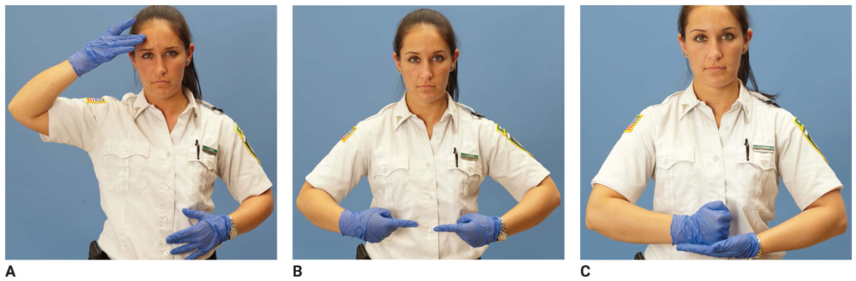
Communicating With Hearing-Impaired Patients (3 of 3)
Steps (cont’d):
  Listen carefully, ask short questions, and give short answers.
  Learn some simple sign language.
FIGURE 4-7 Learn simple phrases in sign language. Signing requires movement and is best learned by attending a sign language class. A. Sick. B. Hurt. C. Help.
A, B, C: © Jones & Bartlett Learning.
Notes:
Lecture Outline
d. Listen carefully, ask short questions, and give short answers.
e. Learn some simple phrases in sign language.
i. It can be useful to know the signs for “sick,” “hurt,” and “help.”

Slide 43
Communicating With Visually Impaired Patients (1 of 3)
Ask the patient if he or she can see at all.
  Visually impaired patients are not necessarily completely blind.
  Expect the patient to have normal intelligence.
Explain everything you are doing as you are doing it.
Notes:
Lecture Outline
L. Communicating with visually impaired patients
1. Ask the patient if he or she can see at all.
a. Visually impaired patients are not necessarily completely blind. Many can perceive light and dark or can see shadows or movement.
b. Expect the patient to have normal intelligence.
2. Explain everything that you are doing as you are doing it.

Slide 44
Communicating With Visually Impaired Patients (2 of 3)
Stay in physical contact with the patient as you begin your care.
If the patient can walk to ambulance, place his or her hand on your arm.
Transport mobility aids such as a cane with the patient to the hospital.
Notes:
Lecture Outline
3. Stay in physical contact with the patient as you begin your care.
4. If the patient can walk to the ambulance, place his or her hand on your arm.
5. Transport mobility aids such as a cane with the patient to the hospital.

Slide 45
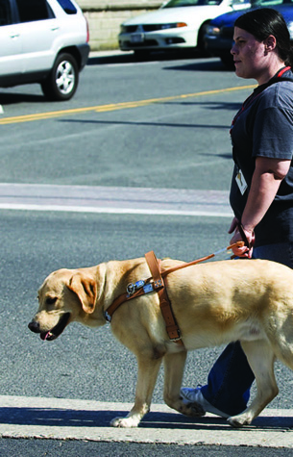
Communicating With Visually Impaired Patients (3 of 3)
Guide dogs
  Easily identified by special harnesses
  If possible, transport dog with patient.
    Alleviates stress for both patient and dog
  Otherwise, arrange for care of the dog.
FIGURE 4-8 A guide dog is easily identified by its special harness.
Courtesy of the Guide Dog Foundation for the Blind. Photographed by Christopher Appoldt.
Notes:
Lecture Outline
6. Guide dogs
a. Easily identified by their special harnesses
b. If possible, transport the dog with the patient.
i. This alleviates stress for both the patient and the dog. Guide dogs are trained not to leave their masters.
c. Otherwise, arrange for care of the dog. A conscious patient can tell you about the dog and give instructions for its care.

Slide 46
Non–English-Speaking Patients (1 of 2)
You must find a way to obtain a medical history.
Find out if the patient speaks some English.
Use short, simple questions.
Point to parts of the body.
Have a family member or friend interpret.
Notes:
Lecture Outline
M. Communicating with non-English-speaking patients
1. You must obtain a medical history even though the patient does not speak English. You cannot skip this step.
2. Find out if the patient knows a few English words or phrases.
3. Use short, simple questions.
4. Point to parts of the body.
5. Have a family member or friend interpret until a professional interpreter is available.

Slide 47
Non–English-Speaking Patients (2 of 2)
Consider learning some common phrases in another language that is used in your area.
  Pocket cards that show the pronunciation of terms are available.
  Use a smartphone app or website to help you translate.
Remember to request a translator at the hospital.
Notes:
Lecture Outline
6. Consider learning some common phrases in another language that is used in your area.
a. Pocket cards that show the pronunciation of terms are available.
b. Use a smartphone app or website to help you translate.
7. Remember to request a translator at the hospital.

Slide 48
Mission-Critical Communications (1 of 2)
Communications where disruption will result in failure of the task at hand
Shared mental model
  A mental model is the picture an individual has in their head of “what’s going on.”
  All team members must share a mental model.
Notes:
Lecture Outline
N. Mission-critical communications
1. Mission-critical communications are any communications where disruption will result in the failure of the task at hand.
2. Shared mental model
a. A mental model is the picture individuals have in their head of “what’s going on.”
b. For any team to work effectively together, all members must share a mental model.

Slide 49
Mission-Critical Communications (2 of 2)
Shared mental model (cont’d)
  Questions to answer:
    What is the focused priority for the patient?
    What is the history of prior care?
    What is the patient’s current state?
    What is the patent’s immediate needs?
Notes:
Lecture Outline
c. To build a mental model, the following questions must be answered:
i. What is the focused priority for the patient? (What is the crux of the problem?)
ii. What is the history of prior care? (What got us to this point?)
iii. What is the patient’s current state? (Where are we now?)
iv. What is the patient’s immediate needs? (What is the very next thing that needs to happen?)
d. Answering the four questions quickly and efficiently will help avoid errors and misunderstandings.

Slide 50
Patient Care Hand-Over (1 of 3)
Effective communication is essential to efficient, effective, and appropriate patient care.
Transfer of pertinent patient information and responsibility for patient care.
Notes:
Lecture Outline
O. Patient care hand-over
1. Effective communication between EMS providers and other health care professionals in the receiving facility is essential to efficient, effective, and appropriate patient care.
2. Patient care hand-over is the transfer of pertinent patient information and the responsibility for patient care.
a. Communication failures between reporting providers and receiving providers is a source of medical liability for provider and organizations.

Slide 51
Patient Care Hand-Over (2 of 3)
Giving the hand-over report
  Initiate eye contact.
  Manage the environment.
  Minimize noise, interruptions, and distractions.
  Ensure the ABCs.
Notes:
Lecture Outline
3. Giving the hand-over report
a. Initiate eye contact
i. Make eye contact with the person with whom the patient is being transferred.
b. Manage the environment
i. Whenever possible, try to minimize noise, interruptions, and distractions.
c. Ensure the ABCs
i. If there is priority critical care that must be initiated or continued, it must be immediately conveyed and addressed by the receiving clinician or team.

Slide 52
Patient Care Hand-Over (3 of 3)
Provide a structured report.
  SBAR (situation, background, assessment, recap/treatment)
  SBAT (situation, background, assessment, treatment)
Provide documentation.
  Should include patient’s priority condition, prior care, current state, and immediate needs
Notes:
Lecture Outline
Provide a structured report
i. SBAR (situation, background, assessment, and recap/treatment)
ii. SBAT (situation, background, assessment, and treatment)
e. Provide documentation
i. The verbal report should consist of the patient’s priority condition, prior care, current state, and immediate needs.

Slide 53
Receiving the Hand-Over Report
Maintain eye contact.
Manage the environment.
Ensure understanding.
Summarize.
Gather supplementary patient documentation.
Notes:
Lecture Outline
4. Receiving the hand-over report
a. Maintain eye contact
b. Manage the environment
c. Ensure understanding
d. Summarize
e. Gather supplementary patient documentation

Slide 54
Written Communications and Documentation (1 of 2)
Patient care report (PCR)
  Also known as prehospital care report
  Legal document
  Records all care from dispatch to hospital arrival
There are two types of PCRs: written and electronic.
Notes:
Lecture Outline
III. Written Communications and Documentation
A. Patient care report (PCR)
1. The PCR is also known as the prehospital care report.
2. It is a legal document used to record all aspects of the care your patient received from initial dispatch to hospital.
3. There are two types of PCRs: written and electronic.

Slide 55
Written Communications and Documentation (2 of 2)
The PCR serves six functions:
  Continuity of care
  Compliance and legal documentation
  Administrative information
  Reimbursement
  Education
  Data collection for continuous quality improvement and research
Notes:
Lecture Outline
4. The PCR serves six functions:
a. Continuity of care
b. Compliance and legal documentation
c. Administrative information
d. Reimbursement
e. Education
f. Data collection for continuous quality improvement

Slide 56
Information Collected on a PCR (1 of 2)
Information collected on the PCR:
  Chief complaint
  Mechanism of injury and illness
  Level of consciousness or mental status
  Vital signs
  Initial and ongoing assessment
  Patient demographics
  Transport information
Notes:
Lecture Outline
B. The following are examples of information collected on a PCR:
1. Chief complaint
2. Mechanism of injury and illness
3. Level of consciousness (using AVPU) or mental status
4. Vital signs
5. Initial and ongoing assessment
6. Patient demographics (age, gender, ethnic background)
7. Transport information (how the patient was moved and reason for destination choice)

Slide 57
Information Collected on a PCR (2 of 2)
Administrative information gathered from a PCR includes when:
  The incident was reported
  The EMS unit was notified
  The EMS unit arrived at the scene
  The EMS unit left the scene
  The EMS unit arrived at the receiving facility
  Patient care was transferred
  The unit is back in service
Notes:
Lecture Outline
C. A lot of administrative information for use in billing, research, and quality improvement can be gathered from a PCR. Examples include when:
1. The incident was reported
2. The EMS unit was notified
3. The EMS unit arrived at the scene
4. The EMS unit left the scene
5. The EMS unit arrived at the receiving facility
6. Patient care was transferred
7. The unit is back in service

Slide 58
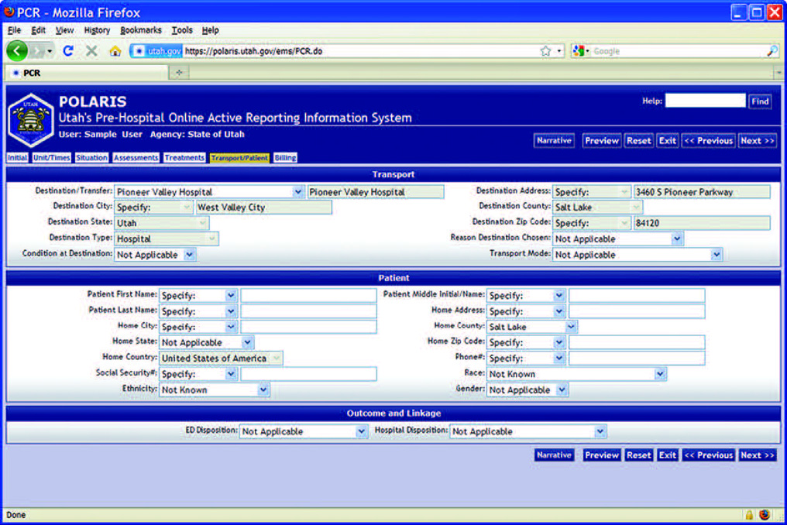
Types of Forms
Traditional written form with:
  Checkboxes
  Narrative section
Computerized version
FIGURE 4-12 An electronic PCR (ePCR).
Courtesy of the Utah Department of Health.
Notes:
Lecture Outline
D. Types of forms
1. Most PCRs are completed in an electronic format referred to as an ePCR.
a. Virtually all are designed to comply with NEMSIS data collection requirements.
b. ePCRs allow patient information to be transmitted directly to hospital computers and may be integrated with the patient’s electronic medical record.
2. The narrative section of the PCR may be the most important.

Slide 59
Standardized Narrative Formats (1 of 3)
CHART method
  Chief complaint or chief concern
  History
  Assessments
  Treatment (Rx)
  Transport
Notes:
Lecture Outline
E. Standardized narrative formats:
1. The two most common narrative formats used in health care are CHART and SOAP.
2. CHART method
a. Stands for chief complaint, history and physical examination, assessment, treatment and transport.
b. Begin with the dispatch information.
c. Chief complaint or chief concern
i. States the condition most urgently requiring EMS intervention.
d. History
i. Includes details relating to the current event and the patient’s medical history prior to this event.
ii. Details come from the patient or others on scene, from dispatch or from the patient record.
e. Assessments
i. Describe all assessments you perform on the patient, including vital signs and the physical examination.
f. Treatment (Rx)
i. Detail all interventions that were performed.
g. Transport
i. Explain how the patient was moved to the ambulance
ii. How the patient was transported (positioned and secure)
iii. Whether emergency lights and sirens were used
iv. Where the patient was taken, including the room number
v. The name of the person to whom the report was given and care was transferred.

Slide 60
Standardized Narrative Formats (2 of 3)
SOAP
  Subjective
  Objective
  Assessment
  Plan
Notes:
Lecture Outline
3. SOAP method
a. Subjective
i. Include information by the patient or others on the scene, such as the chief complaint, events leading up tot the incident, mechanism of injury and past medical history.
b. Objective
i. Include details you gather primarily through patient assessment, such as vital signs, physical exam findings, and other measurements, such as blood glucose or oxygen saturation.
c. Assessment
i. Summarize key findings. If appropriate, provide your impression of what the patient’s problem might be (eg, possible fractured lower leg or possible stroke).
d. Plan
i. Document treatment provided for the patient.

Slide 61
Standardized Narrative Formats (3 of 3)
All narrative sections should contain:
  Time of events
  Assessment findings
  Emergency medical care provided
  Changes in the patient after treatment
  Observations at the scene
  Final patient disposition
  Refusal of care
  Staff person who continued care
Notes:
Lecture Outline
4. Regardless of the method used, the PCR’s narrative section should include:
a. Time of events
b. Assessment findings
c. Emergency medical care provided
d. Changes in the patient after treatment
e. Observations at the scene
f. Final patient disposition
g. Refusal of care
h. Staff person who continued care.
5. In written documentation, avoid radio codes and abbreviations.
6. All PCR’ are confidential documents.
7. Once complete, distribute copies to the appropriate locations

Slide 62
Health Information Exchanges (HIEs) (1 of 2)
Improves sharing of data between EMS and other health care providers
Allows
  Access to relevant health data
  Unnecessary duplication of effort in data entry
  Access to patient outcomes related to hospital care
  Contribution and access to electronic health information on a regular basis and during a disaster
Notes:
Lecture Outline
G. Health information exchanges (HIEs)
1. Improves the sharing of data between EMS and other health care providers.
2. Allow EMS providers to access relevant health data, avoid unnecessary duplication of effort in data entry, and view patient outcomes related to hospital care.
3. Allow EMTs to contribute to and access electronic health information on both a regular basis and during times of disaster.

Slide 63
Health Information Exchanges (HIEs) (2 of 2)
Most HIEs follow the SAFR framework.
  Search
    Hospital and other records
  Alert
    Notifies hospitals of incoming patients
  File
    Incorporates data directly into the patient’s health records
  Reconcile
    Outcomes and other data provided to EMS agencies for billing and QI
Notes:
Lecture Outline
4. Most HIEs follow the SAFR framework:
a. Search
i. EMS providers can search for hospital and other records that will help make treatment and transport decisions.
b. Alert
i. Hospitals are notified of incoming EMS patients with automated systems that populate ED dashboards with information entered by EMS in the field.
c. File
i. Data in the EMS electronic patient care reports are incorporated directly into patient’s longitudinal health records.
d. Reconcile
i. Feedback on outcomes and other hospital data are provided to EMS agencies for billing and quality improvement.

Slide 64
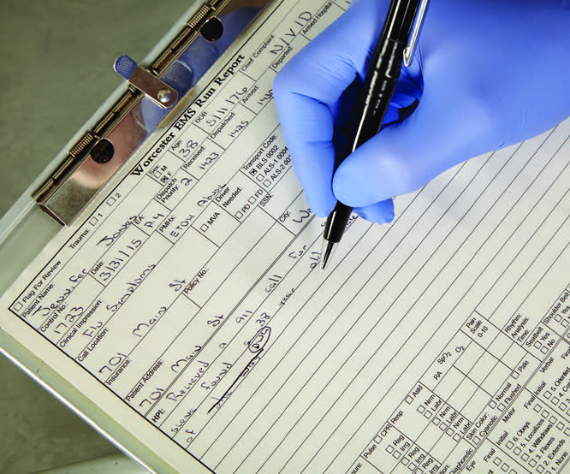
Reporting Errors (1 of 2)
If you leave something out or record it incorrectly, do not try to cover it up.
Falsification:
  Results in poor patient care
  May result in suspension and/or legal action
FIGURE 4-13 If you make a mistake on a handwritten report, the proper way to correct it is to draw a single horizontal line through the error, initial it, and write the correct information next to it.
© Jones & Bartlett Learning.
Notes:
Lecture Outline
H. Reporting errors
1. If you leave something out or record it incorrectly, do not try to cover it up.
2. Falsification:
a. Results in poor patient care
b. May result in suspension and/or legal action

Slide 65
Reporting Errors (2 of 2)
If you discover an error as you are writing your report, draw a single horizontal line through the error, initial it, and write the correct information next to it.
If an error is discovered after you submit your report, follow the same process.
Notes:
Lecture Outline
3. If you discover an error as you are writing your report, draw a single horizontal line through the error, initial it, and write the correct information next to it.
a. Do not try to erase or cover the error with correction fluid.
4. If an error is discovered after you submit your report, follow the same process.
a. Add a note with the correct information.
b. If information was accidentally omitted, begin the new section with the word “addendum”, add the new information, then add the date and your initials.

Slide 66
Documenting Refusal of Care
A common source of lawsuits
  Thorough documentation is crucial.
Document any assessment findings and emergency medical care given.
Have patient sign a refusal of care form.
  Have family member, police officer, or bystander also sign as witness.
Complete the PCR.
Notes:
Lecture Outline
I. Documenting refusal of care
1. Refusal of care is a common source of lawsuits.
a. Thorough documentation is crucial.
2. Document any assessment findings and emergency medical care given.
3. Have the patient sign a refusal of care form.
a. Have a family member, police officer, or bystander also sign the refusal of care form as a witness.
4. Depending on local requirements, the PCR might contain:
a. Complete assessment
b. Evidence that the patient is able to make a rational, informed decision
c. Discussion with the patient as to what care/transportation EMS recommends
d. Discussion with the patient as to what may happen if he or she does not allow care or transportation
e. Discussion with family, friends, and bystanders to try to encourage the patient to allow care
f. Discussion with medical direction according to local protocol
g. Providing the patient with other alternatives—for example, going to see his or her family doctor, or having a family member drive him or her to the hospital
h. Willingness of EMS to return
i. Signatures
5. Complete the PCR.

Slide 67
Special Reporting Situations
Depending on local requirements:
  Gunshot wounds
  Dog bites
  Some infectious diseases
  Suspected physical or sexual abuse
  Multiple-casualty incident (MCI)
Notes:
Lecture Outline
J. Special reporting situations
1. Depending on local requirements:
a. Gunshot wounds
b. Dog bites
c. Certain infectious diseases
d. Suspected physical or sexual abuse
e. Multiple-casualty incident (MCI)

Slide 68
Communications Systems and Equipment
Radio and telephone communications link you and your team with other members of the EMS, fire, and law enforcement communities.
Help the entire team work together more effectively
Provide an important layer of safety and protection
Notes:
Lecture Outline
Communications Systems and Equipment
A. Radio and telephone communications link you and your team with other members of the EMS, fire, and law enforcement communities.
1. Help the entire team to work together more effectively
2. Provide an important layer of safety and protection

Slide 69
Base Station Radios
Contains a transmitter and a receiver in a fixed place
Two-way radio consists of a transmitter and a receiver.
A dedicated line, also known as a hotline, is used for specific point-to-point contact.
Notes:
Lecture Outline
B. Base station radios
1. A base station is any radio hardware containing a transmitter and a receiver that is located in a fixed place.
2. A two-way radio consists of a transmitter and a receiver.
a. May also be equipped with one multichannel and several single-channel receivers.
b. A channel is an assigned frequency or frequencies used to carry voice and/or data communications.
3. A dedicated line, also known as a hotline, is used for specific point-point contact.

Slide 70
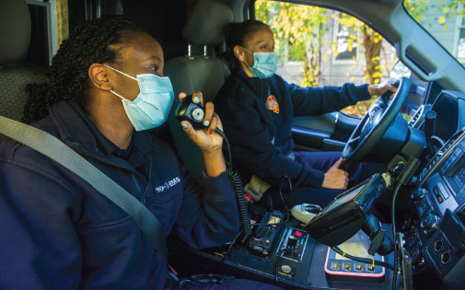
Mobile and Portable Radios (1 of 2)
Mobile radio is installed in a vehicle.
Used to communicate with:
  Dispatcher
  Medical control
Ambulances often have more than one.
FIGURE 4-15 Some ambulances have more than one mobile radio to allow communications with hospitals, mutual aid jurisdictions, and other agencies.
© Jones & Bartlett Learning. Courtesy of MIEMSS.
Notes:
Lecture Outline
C. Mobile and portable radios
1. A mobile radio is installed in a vehicle.
2. Mobile radios are used in the ambulance to communicate with:
a. The dispatcher
b. Medical control
3. An ambulance often has more than one mobile radio.

Slide 71
Mobile and Portable Radios (2 of 2)
Portable radios are hand-held devices.
Essential at the scene of an MCI
Helpful when away from the ambulance to communicate with:
  Dispatch
  Another unit
  Medical control
Notes:
Lecture Outline
4. Portable radios are hand-held devices.
5. Portable radios are essential at the scene of an MCI.
6. When away from the ambulance, a portable radio is helpful to communicate with:
a. Dispatch
b. Another unit
c. Medical control

Slide 72
Repeater-Based Systems (1 of 2)
A repeater is a special base station radio.
  Receives messages and signals on one frequency
  Automatically retransmits them on a second frequency
  Allows two mobile or portable units that cannot reach each other directly to communicate using its greater power and antenna
Notes:
Lecture Outline
D. Repeater-based systems
1. A repeater is a special base station radio.
a. Receives messages and signals on one frequency
b. Automatically retransmits them on a second frequency
c. Allows two mobile or portable units that cannot reach each other directly to communicate using its greater power and antenna

Slide 73
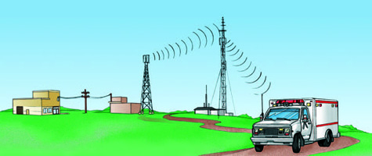
Repeater-Based Systems (2 of 2)
FIGURE 4-17 A message is sent from the control center to the transmitter by a landline. The radio carrier wave is picked up by the repeater for rebroadcast to outlying units. Return radio traffic is picked up by the repeater and rebroadcast to the control center.
© Jones & Bartlett Learning.
Notes:
The figure on this slide illustrates how repeater-based systems work. A message is sent from the control center to the transmitter by a landline. The radio carrier wave is picked up by the repeater for rebroadcast to outlying units. Return radio traffic is picked up by the repeater and rebroadcast to the control center.

Slide 74
Digital Equipment
Telemetry allows electronic signals to be converted into coded, audible signals.
  Signals can be transmitted by radio or telephone to a receiver with a decoder at the hospital.
  Data from cardiac monitors can be transmitted via Bluetooth-enabled mobile devices.
Notes:
Lecture Outline
E. Digital equipment
1. Telemetry allows electronic signals to be converted into coded, audible signals.
a. Signals can be transmitted by radio or telephone to a receiver with a decoder at the hospital.
b. Data from cardiac monitors can be transmitted via Bluetooth-enabled mobile devices to monitoring centers.
2. Digital signals are also used in some kinds of paging and tone-alerting systems.

Slide 75
Cellular/Satellite Telephones
EMTs often communicate with receiving facilities by cellular telephone.
  Simply low-power portable radios
Satellite phones (satphones) are another option.
A scanner is a radio receiver that scans across several frequencies.
  Conversations can be easily overheard.
Notes:
Lecture Outline
F. Cellular/satellite telephones
1. EMTs often communicate with receiving facilities by cellular telephone.
2. Satellite phones (satphones) are another option.
3. A scanner is a radio receiver that searches or scans across several frequencies, stops whenever it receives a radio broadcast on that frequency, and continues once the message is complete.
a. Conversations can be easily overheard.

Slide 76
Other Communications Equipment (1 of 2)
Ambulances usually have an external public address system.
EMS systems may use a variety of two-way radio hardware.
  Simplex is push to talk, release to listen.
  Duplex is simultaneous talk–listen.
  Multiplex utilizes two or more frequencies
MED channels are reserved for EMS use.
Notes:
Lecture Outline
G. Other communications equipment
1. Ambulances usually have an external public address system.
2. EMS systems may use a variety of two-way radio hardware.
a. Simplex is push to talk, release to listen.
b. Duplex is simultaneous talk–listen.
c. Multiplex utilizes two or more frequencies, which enables more than one transmission to occur simultaneously.
3. MED channels are reserved for EMS use.

Slide 77
Other Communications Equipment (2 of 2)
Trunking systems assign many frequencies.
An interoperable communications system allows all of the agencies involved to share valuable information in real time.
Mobile data terminals inside ambulance
  Receive data directly from dispatch center
  Allow for expanded communication capabilities (eg, maps)
Notes:
Lecture Outline
4. Trunking, or 800-MHz, systems assign many frequencies allowing the computer to constantly monitor for an open frequency.
5. An interoperable communications system allows all of the agencies involved to share valuable information with one another in real time.
6. Mobile data terminals (MDTs) inside ambulance
a. Receive data directly from dispatch center
b. Allow for expanded communication capabilities
i. For example, maps

Slide 78
Radio Communications
The Federal Communications Commission (FCC) regulates all radio operations in the United States
  Allocates specific radio frequencies
  Licenses call signs
  Establishes licensing standards and operating specifications
  Establishes limitations for transmitter output
  Monitors radio operations
Notes:
Lecture Outline
V. Radio Communications
A. The Federal Communications Commission (FCC) regulates all radio operations in the United States.
1. The FCC has five principal EMS-related responsibilities.
a. Allocate specific radio frequencies for use by EMS providers
b. License base stations and assigning appropriate radio call signs for those stations
c. Establish licensing standards and operating specifications for radio equipment used by EMS providers
d. Establishing limitations for transmitter power output
e. Monitoring radio operations
2. The FCC’s rules and regulations section (part 90, subpart B) deals with EMS communications issues.

Slide 79
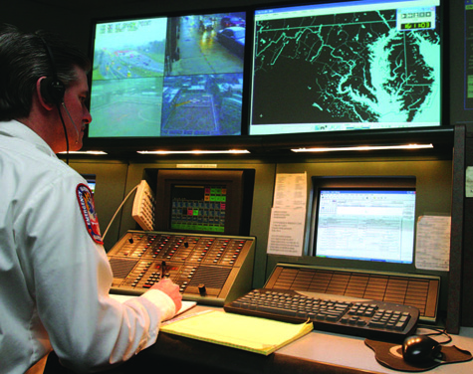
Responding to the Scene (1 of 3)
The dispatcher
  Receives and determines the relative importance of the 9-1-1 call
  Assigns appropriate EMS response unit(s)
FIGURE 4-19 You will be assigned to a call by the dispatcher.
© Jones & Bartlett Learning. Courtesy of MIEMSS.
Notes:
Lecture Outline
B. Responding to the scene
1. The dispatcher receives the first call to 9-1-1.
2. Responsibilities of the dispatcher:
a. Properly screen and assign priority to each call (according to predetermined protocols)
b. Select and alert the appropriate EMS response unit(s)
c. Dispatch and direct EMS response unit(s) to the correct location
d. Coordinate EMS response unit(s) with other public safety services until the incident is over
e. Provide emergency medical instructions to the telephone caller

Slide 80
Responding to the Scene (2 of 3)
The dispatcher (cont’d)
  Selects, dispatches, and directs the appropriate EMS response unit(s)
  Coordinates with other public safety services
  Provides emergency medical instructions to the telephone caller
Notes:
Lecture Outline
3. The dispatcher assigns the appropriate EMS response unit(s) based on several criteria:
a. Nature and severity of the problem
b. Anticipated response time to the scene
c. Level of training of available EMS response unit(s)
d. The need for additional support
4. Dispatcher should give the responding unit(s) the following information:
a. Nature and severity of the injury, illness, or incident
b. Exact location of the incident
c. Number of patients
d. Responses by other public safety agencies
e. Special directions or advisories (adverse road or traffic conditions or severe weather reports)
f. Time unit(s) are dispatched

Slide 81
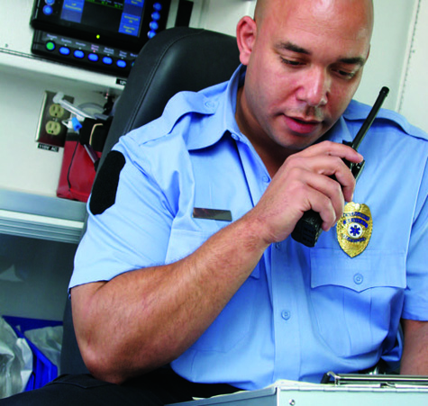
Responding to the Scene (3 of 3)
EMTs report any problems that took place during a run to the dispatcher.
EMTs inform the dispatcher upon arrival at the scene.
FIGURE 4-20 The patient report should be given in an objective, accurate, and professional manner.
© Jones & Bartlett Learning. Courtesy of MIEMSS.
Notes:
Lecture Outline
5. EMTs report any problems that took place during a run to the dispatcher.
6. EMTs inform the dispatcher upon arrival at the scene.
a. Arrival report should include any obvious details observed during scene size-up.
b. Radio communications must be brief and easily understood.
c. Speaking in plain English and do not use code words
d. Report only important information.

Slide 82
Communicating With Medical Control and
Hospitals (1 of 2)
The principal reason for radio communication is to facilitate communication between you and medical control.
Medical control may be located at the receiving hospital, at another facility, or sometimes even in another city or state.
Notes:
Lecture Outline
C. Communicating with medical control and hospitals
1. The principal reason for radio communication is to facilitate communication between you and medical control (and the hospital).
2. Medical control may be located at the receiving hospital, in another facility, or sometimes even in another city or state.

Slide 83
Communicating With Medical Control and
Hospitals (2 of 2)
Consulting with medical control serves several purposes:
  Notifies the hospital of an incoming patient
  Provides an opportunity to request advice or orders from medical control
  Advises the hospital of special situations
Notes:
Lecture Outline
3. Consulting with medical control serves several purposes.
a. Notifies the hospital of an incoming patient
b. Provides an opportunity to request advice or receive orders from medical control
c. Advises the hospital of special situations
4. Plan and organize your radio communication before you transmit

Slide 84
Giving a Patient Report (1 of 2)
The report commonly includes the following 10 elements:
  Your unit identification and level of services
  Any special “alert” indicated by the patient’s condition
  The receiving hospital and your estimated time of arrival (ETA)
  The patient’s age and gender
  The patient’s chief complaint
Notes:
Lecture Outline
D. Giving the patient report
1. The report commonly includes the following 10 elements:
a. Your unit identification and level of services
b. Any special “alert” indicated by the patient’s condition
c. The receiving hospital and your estimated time of arrival (ETA)
d. The patient’s age and gender
e. The patient’s chief complaint or your perception of the problem and its severity

Slide 85
Giving a Patient Report (2 of 2)
The report commonly includes the following 10 elements (cont’d):
  A brief history of the patient's problem
  A brief report of physical findings
  A brief summary of the care given
  A brief description of the patient’s response to treatment
  Any questions or orders from the receiving facility
Notes:
Lecture Outline
f. A brief history of the patient’s current problem
g. A brief report of physical findings
h. A brief summary of the care given
i. A brief description of the patient’s response to the treatment provided
j. Determine whether the receiving facility has any additional questions or orders.

Slide 86
The Role of Medical Control (1 of 2)
Medical control is either off-line (indirect) or online (direct).
You may need to call medical control for permission to:
  Administer certain treatments.
  Determine the transport destination of patients.
  Stop treatment and/or not transport a patient.
Notes:
Lecture Outline
E. Role of medical control
1. Medical control is either off-line (indirect) or online (direct).
2. Depending on how the protocols are written, you may need to call medical control for direct orders (permission) to conduct certain tasks:
a. Administering certain treatments
b. Determining the transport destination of patients
c. Stopping treatment and/or not transporting a patient

Slide 87
The Role of Medical Control (2 of 2)
In most areas, medical control is provided by the physicians working at the receiving hospital.
Many variations have developed across the country.
  Freestanding center
  Individual physician
Notes:
Lecture Outline
3. In most areas, medical control is provided by the physicians working at the receiving hospital.
4. Many variations have developed across the country.
a. In some areas medical direction may come from a freestanding center or from an individual physician.

Slide 88
Calling Medical Control (1 of 3)
There are a number of ways to control access on ambulance-to-hospital channels.
  The dispatcher monitors and assigns appropriate, clear medical control channels.
  Centralized medical emergency dispatch or resource coordination centers
Notes:
Lecture Outline
F. Calling medical control
1. There are a number of ways to control access on ambulance-to-hospital channels.
a. The dispatcher monitors and assigns appropriate, clear medical control channels.
b. Centralized medical emergency dispatch or resource coordination centers

Slide 89
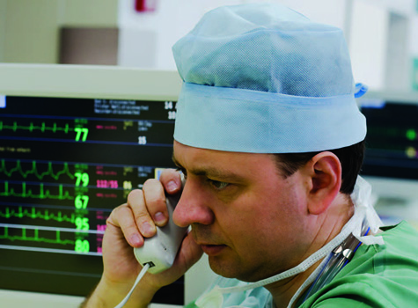
Calling Medical Control (2 of 3)
Be precise and deliver important information.
Never use codes unless directed to do so by local protocol.
FIGURE 4-21 Medical control must be readily available on the radio or telephone at the hospital.
© Andrei Malov/Dreamstime.com.
Notes:
Lecture Outline
2. Your report must be precise and contain only important information.
3. Never use codes when communicating with medical control, unless you are directed to do so by local protocol.

Slide 90
Calling Medical Control (3 of 3)
Repeat orders back word for word and then receive confirmation.
Do not blindly follow an order that does not make sense to you.
Notes:
Lecture Outline
4. Once you receive an order from medical control, repeat the order back word for word and then receive confirmation.
5. Do not blindly follow an order that does not make sense to you.

Slide 91
Information Regarding Special Situations (1 of 2)
You may initiate communication with hospitals to advise them of an extraordinary call or situation.
Example special situations:
  Hazardous materials situations
  Rescues in progress
  Multiple-casualty incidents
Notes:
Lecture Outline
G. Information regarding special situations
1. You may initiate communication with hospitals to advise them of an extraordinary call or situation.
a. A small rural hospital may be better able to respond to multiple patients from a highway crash if notified when the ambulance is first responding.
b. An entire hospital system must be notified of any disaster.
2. Other special situations:
a. Hazardous materials situations
b. Rescues in progress
c. Multiple-casualty incidents

Slide 92
Information Regarding Special Situations (2 of 2)
Keep several points in mind:
  The earlier the notification, the better.
  Provide an estimate of the number of patients.
  Identify any special needs.
Follow your system’s plan.
Notes:
Lecture Outline
8. When notifying the hospital of special situations, keep several points in mind:
a. The earlier the notification, the better.
b. Provide an estimate of the number of individuals who may need to be transported to the facility.
c. Identify any special needs the patients might have (eg, burns or hazardous materials exposure) to assist the hospital in preparation.
9. Follow the plan for your system.

Slide 93
Maintenance of Radio Equipment
Like other EMS equipment, radio equipment must be serviced.
At the beginning of your shift, check the radio equipment.
Radio equipment may fail during a run.
  Follow your backup plan.
Notes:
Lecture Outline
H. Maintenance of radio equipment
1. Like other EMS equipment, radio equipment must be serviced.
2. At the beginning of a shift, check the radio equipment.
3. Radio equipment may fail during a run.
a. The backup plan must then be followed.
b. Standing orders: written documents signed by the EMS systems medical director outlining specific directions, permissions, and sometimes prohibitions regarding patient care
i. When properly followed, they have the same authority and legal status as orders given over the radio.

Slide 94
Review
When health care providers force their cultural values onto their patients because they believe their values are better, they are displaying:
  ethnocentrism.
  proxemics.
  nonverbal communication.
  cultural imposition.

Slide 95
Review
Answer: D
Rationale: Forcing your own cultural values onto others because you believe your values are better is referred to as cultural imposition.

Slide 96
Review
When health care providers force their cultural values onto their patients because they believe their values are better, they are displaying:
  ethnocentrism.
  Rationale: Ethnocentrism means considering your own cultural values as more important.
  proxemics.
  Rationale: Proxemics is the study of space and how the distance between people affects communication.
  nonverbal communication.
  Rationale: Nonverbal communication refers to any communication that does not use language.
  cultural imposition.
  Rationale: Correct answer

Slide 97
Review
When communicating with an older patient, you should:
  approach the patient slowly and calmly.
  step back to avoid making the patient uncomfortable.
  raise your voice to ensure that the patient can hear you.
  obtain the majority of your information from family members.

Slide 98
Review
Answer: A
Rationale: Approach an older patient slowly and calmly, use him or her as your primary source of information whenever possible, and allow ample time for the patient to respond to your questions. Not all older patients are hearing impaired; if the patient is hearing impaired, you may need to elevate your voice slightly.

Slide 99
Review
When communicating with an older patient, you should:
  approach the patient slowly and calmly.
  Rationale: Correct answer
  step back to avoid making the patient uncomfortable.
  Rationale: You may need to get closer. You have to touch the patient to take vital signs.
  raise your voice to ensure that the patient can hear you.
  Rationale: Not all older patients are hearing impaired.
  obtain the majority of your information from family members.
  Rationale: Always speak to the patient; the patient’s responses can provide unlimited information.

Slide 100
Review
While caring for a 5-year-old boy with respiratory distress, you should:
  avoid direct eye contact with the child, as this may frighten him.
  avoid letting the child hold any toys, as this may hinder your care.
  avoid alerting the child prior to a patient procedure.
  allow a parent or caregiver to hold the child if the situation allows.

Slide 101
Review
Answer: D
Rationale: When caring for children, take special care to avoid upsetting them. Allowing a parent to hold the child or allowing the child to play with a favorite toy often helps to keep the child calm. Never lie to a child, or any other patient for that matter; children can see through lies and deceptions. Assure the child that you can be trusted and are there to help by maintaining eye contact.

Slide 102
Review
While caring for a 5-year-old boy with respiratory distress, you should:
  avoid direct eye contact with the child, as this may frighten him.
  Rationale: Eye contact helps to establish trust with children.
  avoid letting the child hold any toys, as this may hinder your care.
  Rationale: Playing with a toy can calm a child and keep the child occupied.
  avoid alerting the child prior to a patient procedure.
  Rationale: Never lie to a child; children can detect deception.
  allow a parent or caregiver to hold the child if the situation allows.
  Rationale: Correct answer

Slide 103
Review
Which of the following pieces of patient information is of LEAST pertinence when giving a verbal report to a nurse or physician at the hospital?
  The patient’s name and age
  The patient’s family medical history
  Vital signs that may have changed
  Medications that the patient is taking

Slide 104
Review
Answer: B
Rationale: Information given to the receiving nurse or physician should include the patient’s name and age, vital signs (especially if they have changed), a summary of the past medical history, and the patient’s response to any treatment that you rendered. Family medical history is not essential in the emergency treatment of a patient.

Slide 105
Review
Which of the following pieces of patient information is of LEAST pertinence when giving a verbal report to a nurse or physician at the hospital?
  The patient’s name and age
  Rationale: This is very important in a verbal report.
  The patient’s family medical history
  Rationale: Correct answer
  Vital signs that may have changed
  Rationale: This is very important in a verbal report.
  Medications that the patient is taking
  Rationale: This is very important in a verbal report.

Slide 106
Review
Which of the following statements about the patient care report (PCR) is true?
  It is not a legal document in the eyes of the law.
  It cannot be used for patient billing information.
  It helps ensure efficient continuity of patient care.
  It is intended for use only by the prehospital care provider.

Slide 107
Review
Answer: C
Rationale: The PCR is an important document for more than one reason. It helps to ensure efficient continuity of patient care by providing the hospital with an account of all prehospital assessments and treatment. It also serves as a legal document that reflects the care provided by the EMT.

Slide 108
Review
Which of the following statements about the patient care report is true?
  It is not a legal document in the eyes of the law.
  Rationale: A patient care report is a legal document.
  It cannot be used for patient billing information.
  Rationale: A patient care report can be used by hospital administration, which includes the billing department.
  It helps ensure efficient continuity of patient care.
  Rationale: Correct answer
  It is intended for use only by the prehospital care provider.
  Rationale: While it may not be read immediately by the hospital, it can be used later to review patient care procedures and for quality improvement purposes.

Slide 109
Review
A device that receives a low-frequency signal and then transmits it at a relatively higher frequency is called a:
  duplex.
  scanner.
  repeater.
  receiver.

Slide 110
Review
Answer: C
Rationale: A repeater receives messages and signals from one frequency and then automatically transmits them on a second, higher frequency.

Slide 111
Review
A device that receives a low-frequency signal and then transmits it at a relatively higher frequency is called a:
  duplex.
  Rationale: Duplex is the ability to transmit and receive messages simultaneously.
  scanner.
  Rationale: A scanner is a device that searches or scans across several frequencies until a message is completed.
  repeater.
  Rationale: Correct answer
  receiver.
  Rationale: A receiver is a device that only receives and does not transmit.

Slide 112
Review
When treating a potentially hostile patient, you should try to diffuse the situation by:
  assuming an aggressive posture.
  staring at the patient.
  speaking calmly, confidently, and slowly.
  verbally threatening the patient.

Slide 113
Review
Answer: C
Rationale: Speak calmly, confidently, and slowly. With your backup clearly visible, advise the patient what needs to be done, or provide the patient with limited, acceptable choices. “Sir, I need you to sit on the ambulance cot now. Either you will sit on the cot, or we will help you to the cot.”

Slide 114
Review
When treating a potentially hostile patient, you should try to diffuse the situation by:
  assuming an aggressive posture.
  Rationale: Do not assume an aggressive posture. Stand with your palms facing out; this communicates openness and acceptance and allows for quick movement, if necessary.
B. staring at the patient.
Rationale: Make good eye contact, but do not stare.
C. speaking calmly, confidently, and slowly.
Rationale: Correct answer.
verbally threatening the patient.
Rationale: Never threaten the patient, either verbally or physically.

Slide 115
Review
All of the following are functions of the emergency medical dispatcher, EXCEPT:
  alerting the appropriate EMS response unit.
  screening a call and assigning it a priority.
  providing emergency medical instructions to the caller.
  providing medical direction to the EMT in the field.

Slide 116
Review
Answer: D
Rationale: Functions of the emergency medical dispatcher include screening a call and assigning it a priority, alerting the appropriate EMS response unit, coordinating EMS units with other public safety services, and providing prearrival emergency medical instructions to the caller.

Slide 117
Review
All of the following are functions of the emergency medical dispatcher, EXCEPT:
  alerting the appropriate EMS response unit.
  Rationale: The dispatcher notifies the closest appropriate EMS unit.
  screening a call and assigning it a priority.
  Rationale: The dispatcher prioritizes incoming calls.
  providing emergency medical instructions to the caller.
  Rationale: The dispatcher helps callers with medical instructions.
  providing medical direction to the EMT in the field.
  Rationale: Correct answer

Slide 118
Review
After receiving an order from medical control over the radio, the EMT should:
  carry out the order immediately.
  disregard the order if it is not understood.
  obtain the necessary consent from the patient.
  repeat the order to the physician word for word.

Slide 119
Review
Answer: D
Rationale: After receiving an order from medical control, the EMT should repeat the order back to the physician word for word. This will ensure that he or she heard the order correctly. After confirming the order, the EMT should obtain the necessary consent from the patient.

Slide 120
Review
After receiving an order from medical control over the radio, the EMT should:
  carry out the order immediately.
  Rationale: The order must be repeated back first to confirm that it was heard correctly.
  disregard the order if it is not understood.
  Rationale: Repeating the order will help the EMT to clarify any misunderstandings.
  obtain the necessary consent from the patient.
  Rationale: This step is carried out after the order has been confirmed and understood by the EMT.
  repeat the order to the physician word for word.
  Rationale: Correct answer

Slide 121
Review
When requesting medical direction for a patient who was involved in a major car accident, the EMT should avoid:
  using radio codes to describe the situation.
  questioning an order that seems inappropriate.
  relaying vital signs unless they are abnormal.
  the use of medical terminology when speaking.

Slide 122
Review
Answer: A
Rationale: When giving a report to medical control or requesting medical direction, the EMT should avoid the use of codes, such as “10-50” or “Signal 70.” One cannot assume that the physician is familiar with these codes. Plain English is more effective.

Slide 123
Review
When requesting medical direction for a patient who was involved in a major car accident, the EMT should avoid:
  using radio codes to describe the situation.
  Rationale: Correct answer
  questioning an order that seems inappropriate.
  Rationale: If an order seems inappropriate, EMS providers must question the validity of the order.
  relaying vital signs unless they are abnormal.
  Rationale: Vital signs are necessary to describe the patient’s condition to the medical director.
  the use of medical terminology when speaking.
  Rationale: The use of appropriate medical terminology shows the EMS provider’s confidence, knowledge, and expertise to the medical director.

